Slide 1
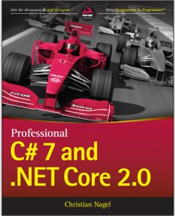
Programming
Chapter 2
Steps in program development

Slide 2
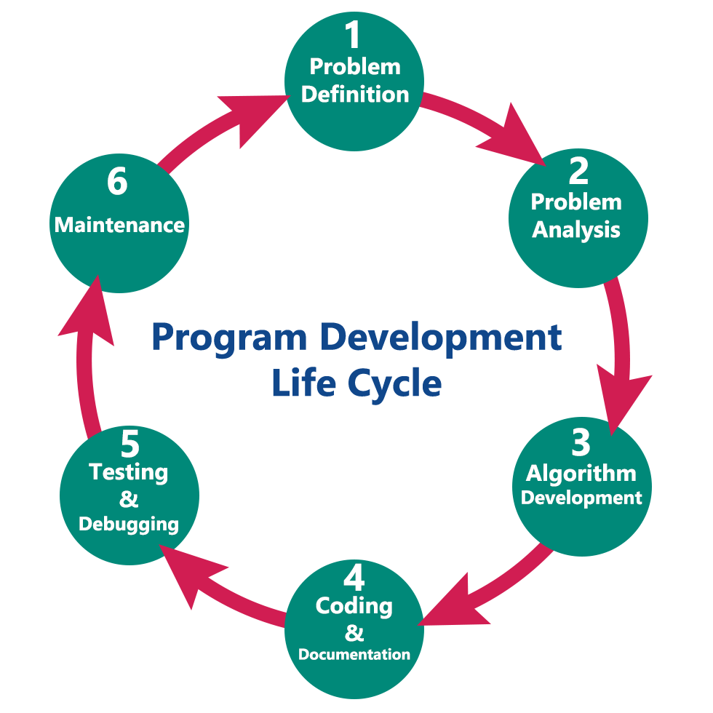
Steps in Program Development
The various steps involved are
Defining or Analyzing the problem
Design (Algorithm)
Coding
Documenting the program
Compiling and running the program
Testing and Debugging
Maintenance

Slide 3
Steps in Program Development: Analyzing or Defining the Problem
The problem is defined by doing a preliminary investigation
Defining a problem helps us to understand problem clearly
It is also known as Program Analysis

Slide 4
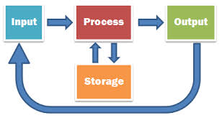
Tasks in defining a problem
Followings are the tasks in order to define a problem
Specifying the input requirements
Specifying the output requirements
Specifying the processing requirements

Slide 5
Specifying the input requirements
The input specification is obtained by answering following questions
What specific values will be provided as input to the program?
What format will the values be?
For each input item, what is the valid range of values that it may assume?
What restrictions are placed on the use of these values?

Slide 6
Specifying the output requirements
The output specification is obtained by answering the following questions
What values will be produced?
What is the format of these values?
What specific annotation, headings, or titles are required in the report?
What is the amount of output that will be produced?

Slide 7
Specifying the processing requirements
The processing requirement is obtained by answering following questions
What is the method (technique) required in producing the desired output?
What are the validation checks that need to be applied to the input data?
What calculations are needed?

Slide 8
Activity 1: Find Factorial Number
Input?
Output?
Process?

Slide 9
Activity 2: Sum of numbers from 1 to n
Input?
Output?
Process?

Slide 10
Activity 1: Find Factorial Number
Input: Positive integer number
Output: Factorial of that number
Process: Solution technique which transforms input to output. Factorial of a number can be calculated by the formula n!=1*2*3*…*n

Slide 11

Activity 2: Sum of numbers from 1 to n
Input: Positive integer number
Output: Sum of numbers from 1 to n
Process: 2 methods
Method A: You can add them up. It might take a while, depending on what N is, but let’s practice with N = 7. 1+2+3+4+5+6+7 = 28.
Method B: You can look into a general case to try to find a formula:

Slide 12
Use-case diagram
Use case diagrams are used to gather the requirements of a system
So when a system is analyzed to gather its functionalities use cases are prepared and actors are identified.
The purposes of use case diagrams can be as follows:
Used to gather requirements of a system
Used to get an outside view of a system
Identify external and internal factors influencing the system
Show the interacting among the requirements are actors
Notes:
Can use https://www.draw.io to draw

Slide 13
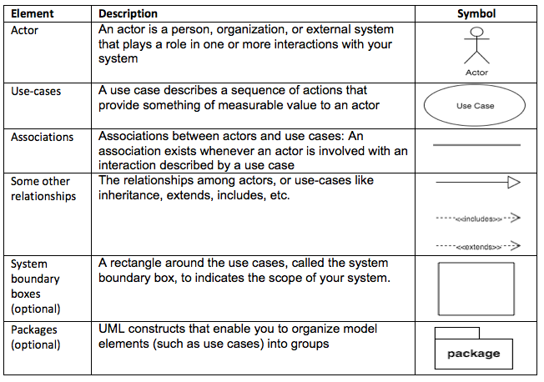
Main elements of use-case diagram

Slide 14
Activity: Draw use-case diagram
You are hired to develop FAI’s library system with following description
Admin who could
Manage books, readers (staff, lecturers, and students), etc.
Manage borrow/return books
Users (staff, lecturers, students) who could
View/search books
Reserve books
Borrow/return books
Please draw Use-case diagram for this scenario

Slide 15
STEPS IN Program Development: Design
A design is the path from the problem to a solution in code
The well designed program is likely to be:
Easier to read and understand later
Less of bugs and errors
Easier to extend to add new features
Easier to program in the first place

Slide 16
Modular Design
Once the problem is defined clearly, several design methodologies can be applied
An important approach is Top-Down program design
It is structured design technique
It breaks up the problem into a set of sub-problems called Modules
It creates a hierarchical structure of the modules

Slide 17
STEPS IN Program Development: Coding
An algorithm expressed in programming languages is called Program
Writing a program is called Coding
The logic that has been developed in the algorithm is used to write program

Slide 18
STEPS IN Program Development: Documenting the Program
Document explains
How the program works and how to use the program (user manual)
How to maintain the program (developer manual)
Details of particular programs, or particular pieces of programs, are easily forgotten or confused without suitable documentation

Slide 19
Forms of documentation
Documentation comes in two forms
External documentation, which includes things such as reference manuals, algorithm descriptions, flowcharts, and project workbooks
Internal documentation, which is part of the source code itself (essentially, the declarations, statements, and comments)

Slide 20
Compiling and Executing the Program
Compilation is a process of translating a source program into machine understandable form
The compiler is system software
It examines each instruction for its correctness
It does the translation
During the execution
Program is loaded into the computer’s memory
The program instructions are executed

Slide 21
STEPS IN Program Development: Testing
Testing is the process of executing a program with the deliberate intent of finding errors
Testing is needed to check whether the expected output matches the actual output
Testing is done during every phase of program development
Initially, requirements can be tested for its correctness
Then, the design (algorithm, flow charts) can be tested for its exactness and efficiency

Slide 22
Test criteria
Programs are tested with several test criteria and the important ones are given below
Test whether each and every statement in the program is executed at least one (Basic path testing)
Test whether every branch in the program is traversed at least once (control flow)
Test whether the input data flows through the program and is converted to an output (data flow)

Slide 23
STEPS IN Program Development: Debugging
Debugging is a process of correcting the errors
Programs may have logical errors which cannot be caught during compilation
Debugging is the process of identifying their root causes
One of the ways is to print out the intermediate results at strategic points of computation
Another way is to use support from the IDE
Testing vs Debugging
Testing means detecting errors
Debugging means diagnosing and correcting the root causes

Slide 24
STEPS IN Program Development: Maintenance
Program maintenance
Continuing process of maintenance and modification
To keep pace with changing requirements and technologies
Maintainability of the program is achieved by
Modularizing it
Providing proper documentation for it
Following standards and conventions (naming conventions, using symbolic constants, etc.)

Slide 25
Introduction to programming language

Slide 26
What is a Programming Language?
It is an art of making a computer to do the required operations
By means of issuing sequence of commands to it
It can be defined as
A vocabulary (unique set of characters/keywords)
A set of grammatical rules (syntax)
The term programming languages usually refers to high-level languages
E.g., BASIC, C, C++, COBOL, FORTRAN, Ada, and Pascal

Slide 27
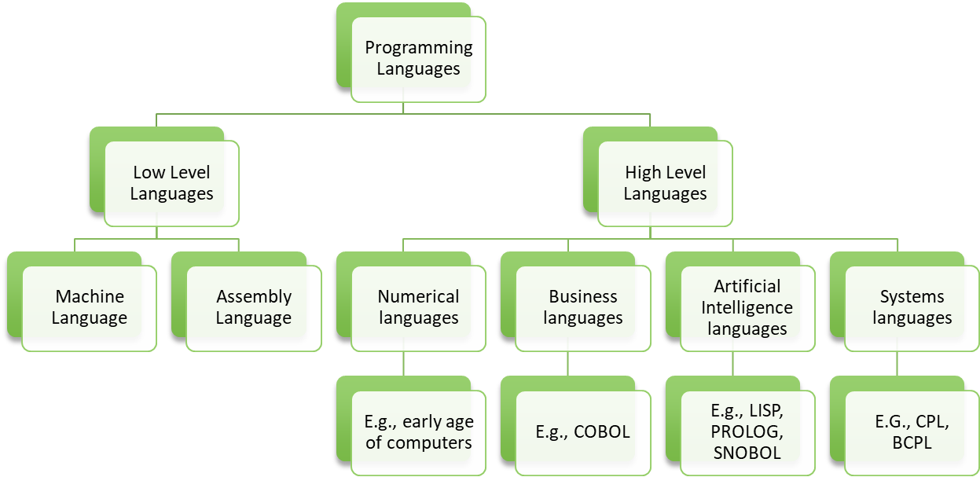
Types of programming languages
There are two major types of programming languages
Low level languages (LLL)
High level languages (HLL)

Slide 28
What makes a good language?
Every language has its strengths and weaknesses
FORTRAN is good for numeric data but not good to organize large program
PASCAL is good for structured and readable programs, but it is not as flexible as C
C++ has powerful object-oriented features, but it is complex and difficult to learn
The choice of PL depends on type of the computer used, type of program, and the expertise of the programmer

Slide 29
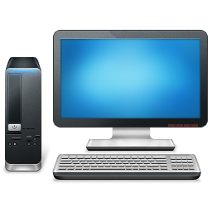

Development Environments
Programming on Host Environment:
The environment under which a program is designed, coded, tested & debugged
Operating on Target Environment
The external environment which supports the execution of a program Target
Hello.c
Hello.exe
Hello.exe
Notes:
Batch-processing: For example, the backup process on an organization. The transaction details of all the departments are collected for backup at one place and the backup is done at a time at the end of the day.

Slide 30
Summary
Draw a mind-map to summarize the content of this lecture

